Slide 1
Ames Housing Sale Price Prediction Model
Ling Chong Gold

Slide 2
Agenda
Background
Methodology
Problem Statement
Gather and Data Cleaning
Exploring Data
Model Data
Second Iteration
Third Iteration
Conclusion

Slide 3
Background
2 datasets of Aimes Iowa Housing Dataset was Provided
Test dataset consists of 80 columns and 879 rows
Create a model for price prediction
Refine and improve the model
Score is calculated based on the Root Mean Square Error after submission to Kaggle

Slide 4
Methodology
Define Problem
Gather
Data
Explore
Data
Answer Problem
Evaluate Model
Model
Data
* Three
Iterations

Slide 5
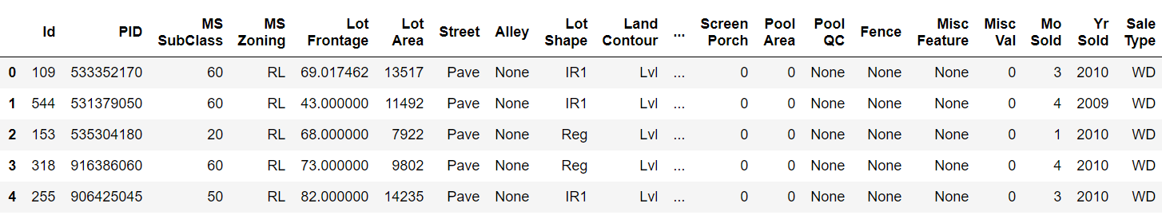

Problem Statement
From the Ames Housing dataset, create a model to predict the sale price and perform improvements to the model after it is created

Slide 6
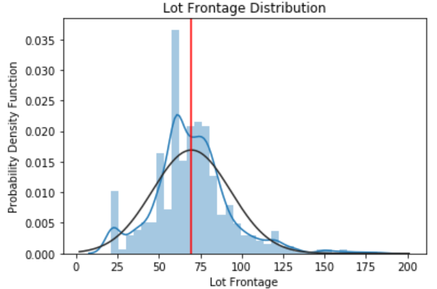
Gathering and Clean Data
Data was provided and there were quite a number of null values
3 Row with Null Values Exclusive to Train dataset was dropped
Most of the null values are due to Python recognizing NA as null
(They are filled with ‘None’ or 0 dependent on the columns data type)
Lot Frontage has a total of 490 null values
(They are filled with the mean)

Slide 7
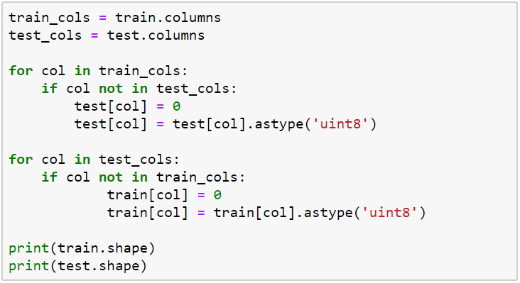
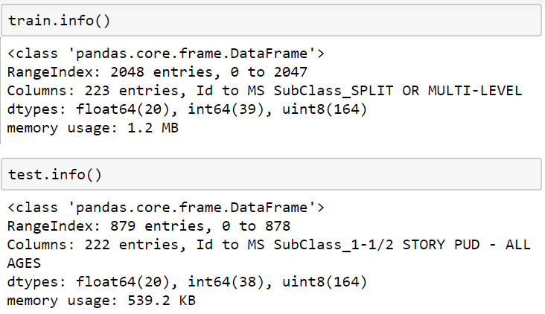
Exploring Data and Feature Engineering
A column for Total Finished Basement Square Feet was created
(Basement Finish Square Feet 1 + Basement Finish Square Feet 2)
Garage Cars Column was dropped
(Details can be inferred from Garage Area)
A column for Age When Sold was created
(Year Sold – Year Built)
Ordinal Encoding was performed for Columns Depicting Quality
(Central Air, Electrical, Functional)
One Hot Encoding was performed for columns with discrete object values

Slide 8
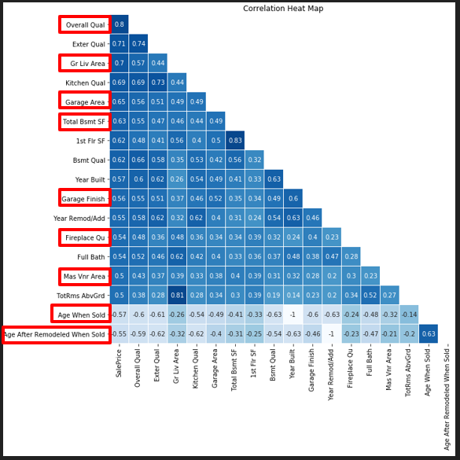
Model Data – 1st Iteration
Features higher than 0.5 in correlation with sale price is selected and heatmap plotted
9 features were selected base on
Their correlation with sale price
They are not correlated with each other
If 2 features are correlated with each other the one with a higher correlation with sale price is selected
Interaction terms related to selected will be created during the next iteration

Slide 9
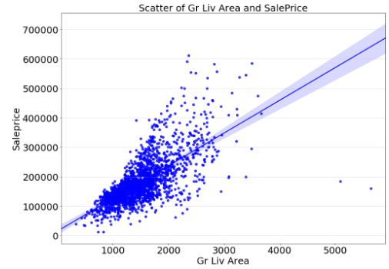
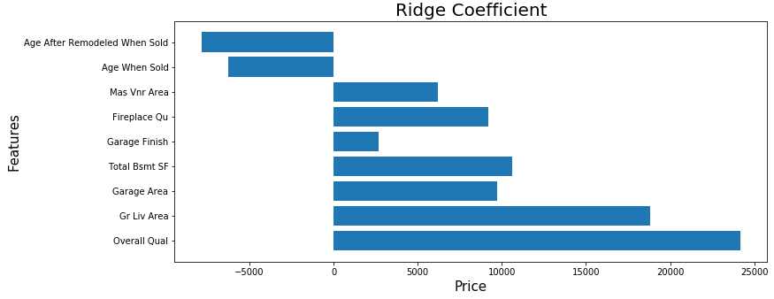
Model Data – 1st Iteration
Outliers was discovered based on scatterplot
These outliers will be removed during the next iteration
1 unit increase in Age After Remodeled When Sold is equals to around 8000 decrease in Sale Price
1 unit increase in Age When Sold is equals to around 5000 decrease in Sale Price
Notes:
1 unit increase in Age After Remodeled When Sold is equals to around 8000 decrease in Sale Price
1 unit increase in Age When Sold is equals to around 5000 decrease in Sale Price
1 unit increase in Mas Vnr Area is equals to around 7000 increase in Sale Price
1 unit increase in Fireplace Qu is equals to around 8000 increase in Sale Price
1 unit increase in Garage Finish is equals to around 3000 increase in Sale Price
1 unit increase in Total Bsmt SF is equals to around 11000 increase in Sale Price
1 unit increase in Garage Area is equals to around 9000 increase in Sale Price
1 unit increase in Gr Liv Area is equals to around 18000 increase in Sale Price
1 unit increase in Overall Qual is equals to around 24000 increase in Sale Price

Slide 10
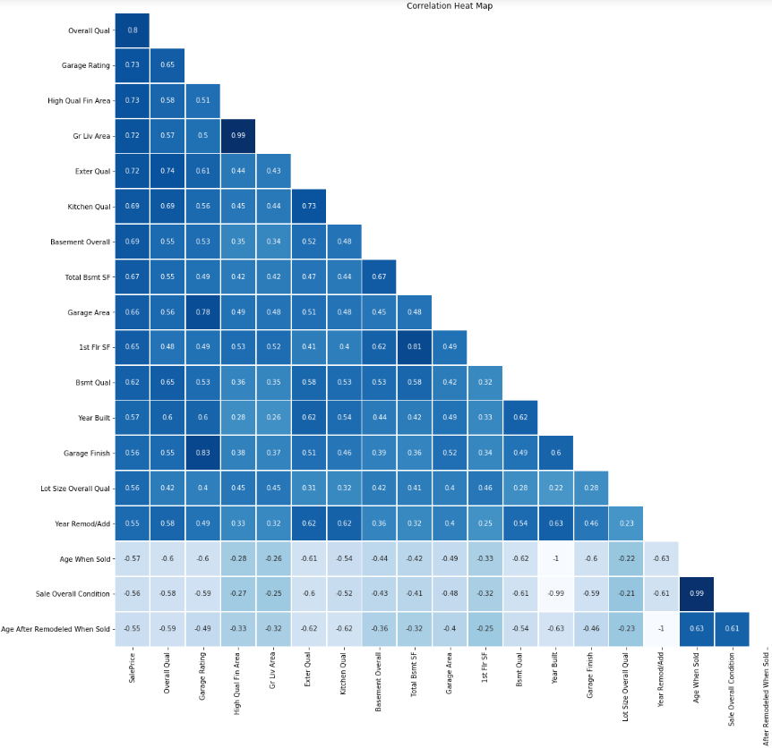
Model Data – 2nd Iteration
High Quality Finish Area was created
Lot Size Overall Quality was created
Garage Overall was created
Fireplace Overall was created
Sale Overall Condition created
Heatmap was plotted again
Top 9 features was selected using the same methodology during the first iteration
Notes:
The following interaction terms were created:
Overall Quality interaction with Lot Size
Overall Quality * Lot Area
Garage is one of the top predictor
Garage Overall = Garage Area * Garage Quality * Garage Condition * Garage Finish
Fireplace is also one of the selected feature
Fireplace Overall = Fireplace Quality * Number of Fireplaces
One more column depicting High Quality Finish area was computed and added
We know that quality and area are top predictors
High Quality Finish Area = Above Grade Liv Area – Low Quality Finish SF

Slide 11
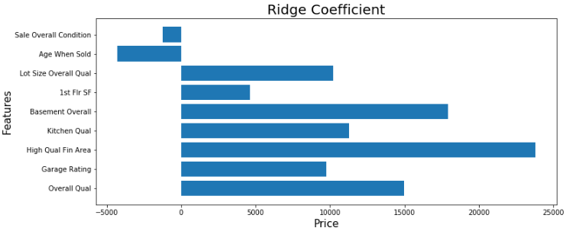
Model Data – 2nd Iteration
1 unit increase in Sale Overall Condition is equals to around 1000 decrease in Sale Price
1 unit increase in Age When Sold is equals to around 4000 decrease in Sale Price
Notes:
1 unit increase in Sale Overall Condition is equals to around 1000 decrease in Sale Price
1 unit increase in Age When Sold is equals to around 4000 decrease in Sale Price
1 unit increase in Lot Size Overall Qual is equals to around 10000 increase in Sale Price
1 unit increase in 1st Flr SF is equals to around 5000 increase in Sale Price
1 unit increase in Basement Overall is equals to around 18000 increase in Sale Price
1 unit increase in Kitchen Qual is equals to around 12000 increase in Sale Price
1 unit increase in High Qual Fin Area is equals to around 23000 increase in Sale Price
1 unit increase in Garage Rating is equals to around 9000 increase in Sale Price
1 unit increase in Overall Qual is equals to around 15000 increase in Sale Price

Slide 12
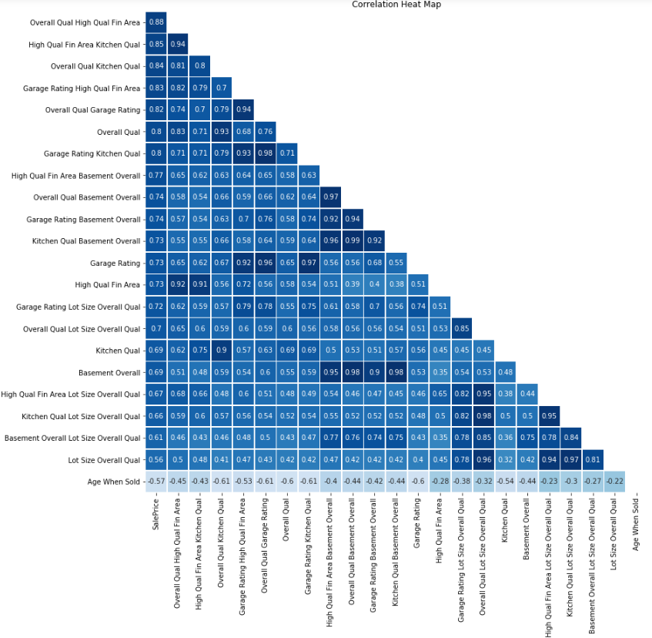
Model Data – 3rd Iteration
Top 9 features was selected and Polynomial Feature was performed on them
Another heatmap was plotted for visualization and select the best predictors based on the same methodology as per previous iterations
6 features was selected

Slide 13
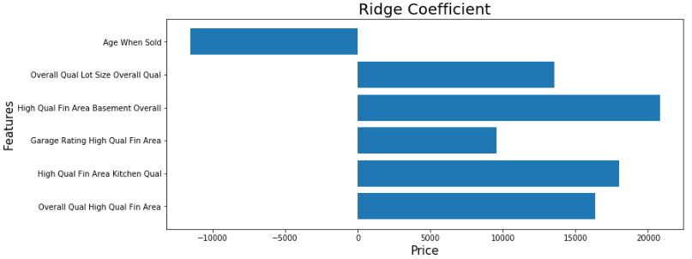
Model Data – 3rd Iteration
1 unit increase in Age When Sold is equals to around 10000 decrease in Sale Price
1 unit increase in the interaction between Overall Qual and Lot Size Overall Qual is equals to around 14000 increase in Sale Price
Notes:
1 unit increase in Age When Sold is equals to around 10000 decrease in Sale Price
1 unit increase in the interaction between Overall Qual and Lot Size Overall Qual is equals to around 14000 increase in Sale Price
1 unit increase in the interaction of High Qual Fin Area and Basement Overall is equals to around 22000 increase in Sale Price
1 unit increase in the interaction of High Qual Fin Area and Kitchen Qual is equals to around 18000 increase in Sale Price
1 unit increase in the interaction of Overall Qual and High Qual Fin Area is equals to around 16000 increase in Sale Price

Slide 14
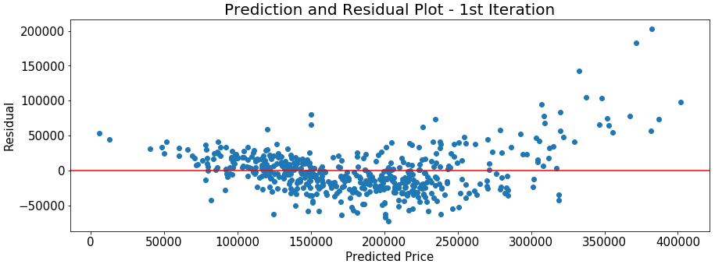
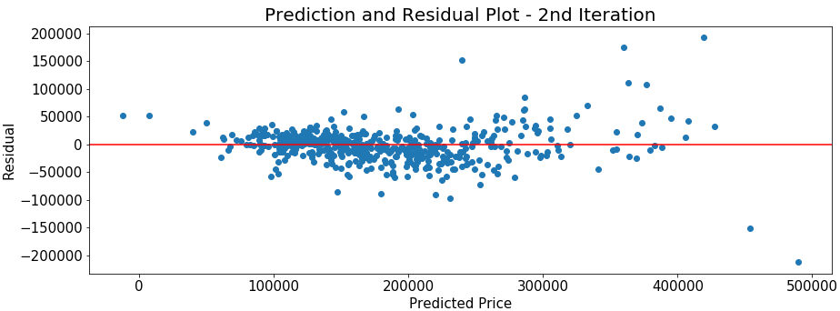
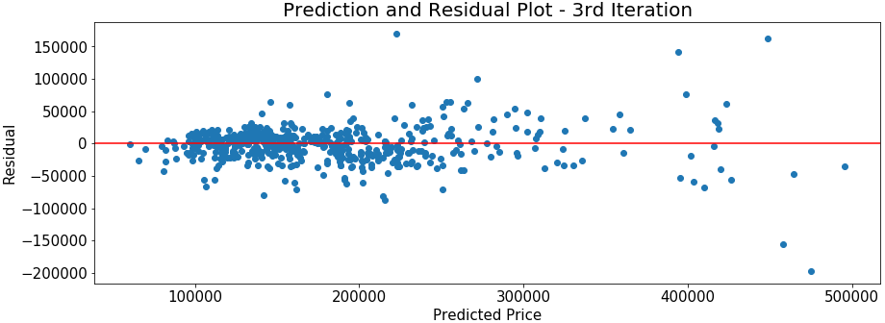
Prediction and Residual Scatter – (Train Test Split)
You would want to see that the points are heteroscedastic signifying that your error rate is consistent
The second iteration performed better than the first, however the error increased as predicted price increase
The third iteration is the best when predicted price is low, but declined when predicted price is high
Notes:
This is the prediction and residual scatter plot plotted for the predictions made during the train-test split

Slide 15
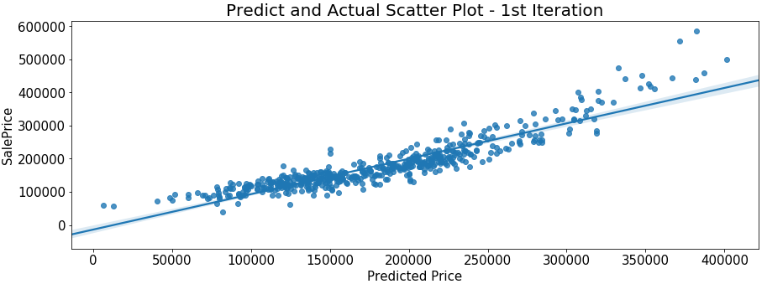
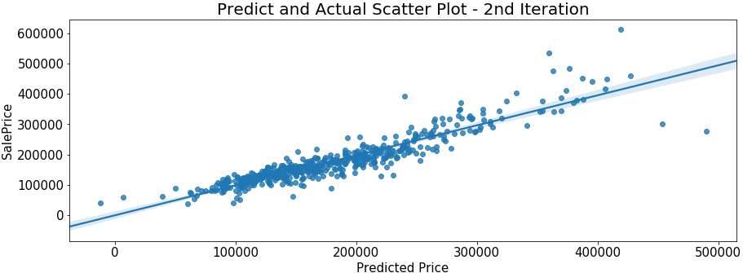
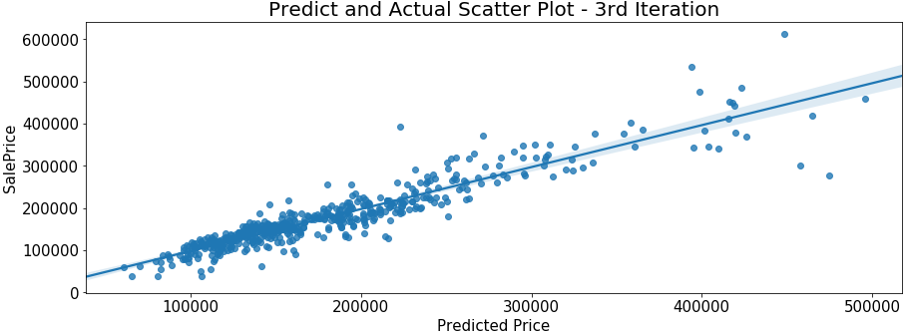
Prediction and Actual Scatter – (Train Test Split)
You would want to see that the points are highly correlated
The second iteration performed better than the first, as the predicted price increase, the points get scattered
The third iteration is the best when predicted price is low, but the points are scattered more when the predicted price is high

Slide 16
Conclusion
The first model submitted to Kaggle for scoring:
- Public Score : 30, 596
- Private Score : 34, 528
The second model submitted to Kaggle for scoring
- Public Score: 26, 639
- Private Score: 39, 360
This means that the second model is not generalized enough
The first model is more generalized despite the higher error rate
I will consider the first model as a better model
More improvements can be made iterating from the first model

